Slide 1
Secondary Science Professional Study Day
August 23, 2022

Slide 2
WELCOME BACK!
Please make sure that you have…
Joined the Secondary Science Group | Joined one or more Resource Sharing Groups
Login to Schoology Join the Secondary Science Group using the Access Code: 2NNCJ-8HTZT | From the main Resources page or within the August 2022 PSD folder, open the Resource Sharing Groups document Use the Access Codes to join the Group(s) of your choice
Notes:
Project as teachers join the session
Start recording

Slide 3
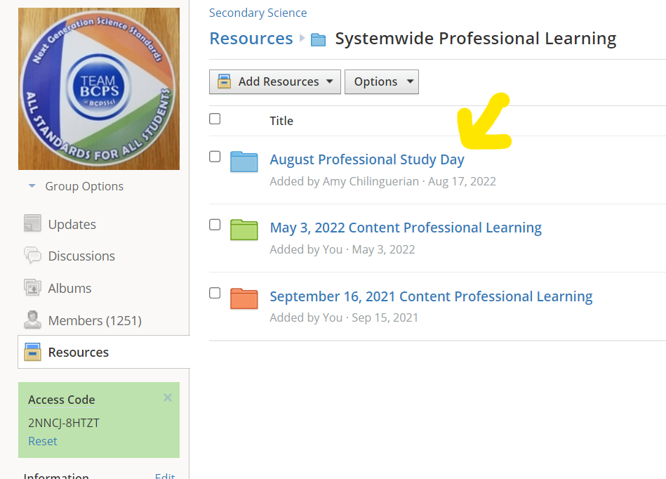
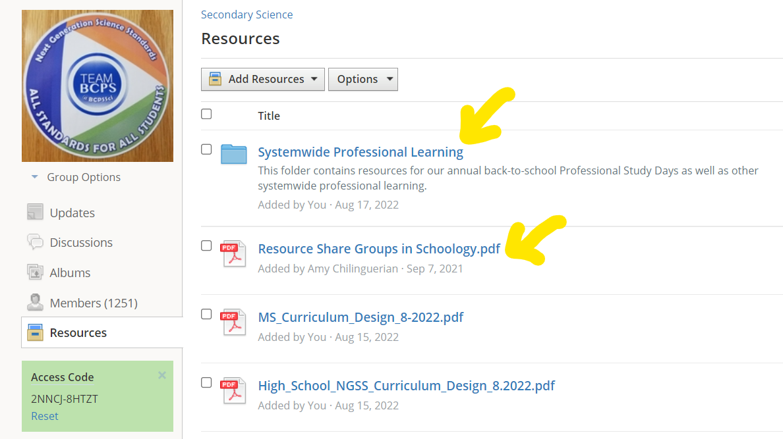
WELCOME BACK!
Within the Secondary Science GROUP...
  Secondary Science GROUP Access Code: 2NNCJ-8HTZT
Notes:
Project as teachers join the session, help folks get into the Secondary Science GROUP and find today’s resources

Slide 4


WELCOME BACK!
What has been the best part of your summer?
What are you looking forward to this year?
Please share your experiences!
@BCPSSci
#SciPSD22 #NGSSNow
#bringingscienceback
Notes:
Start by 8am – START RECORDING and remind participants they are being recorded
Encourage teachers to share their PSD experiences through social media

Slide 5
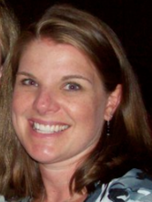
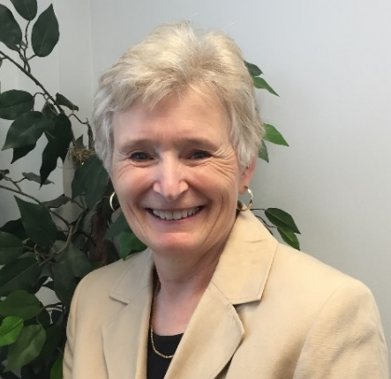
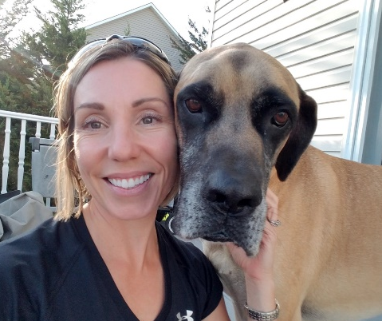
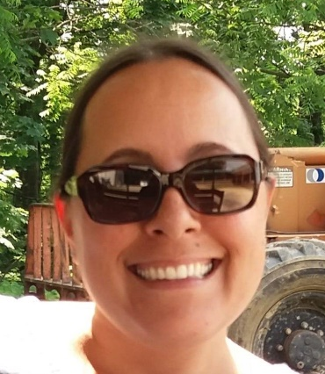
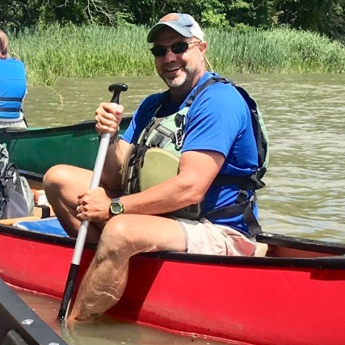
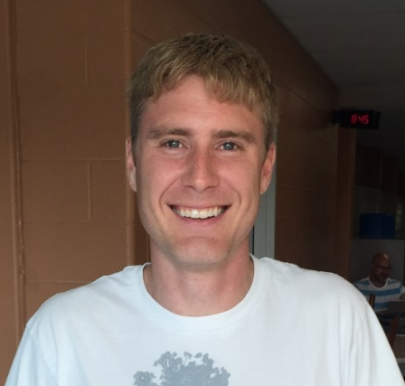
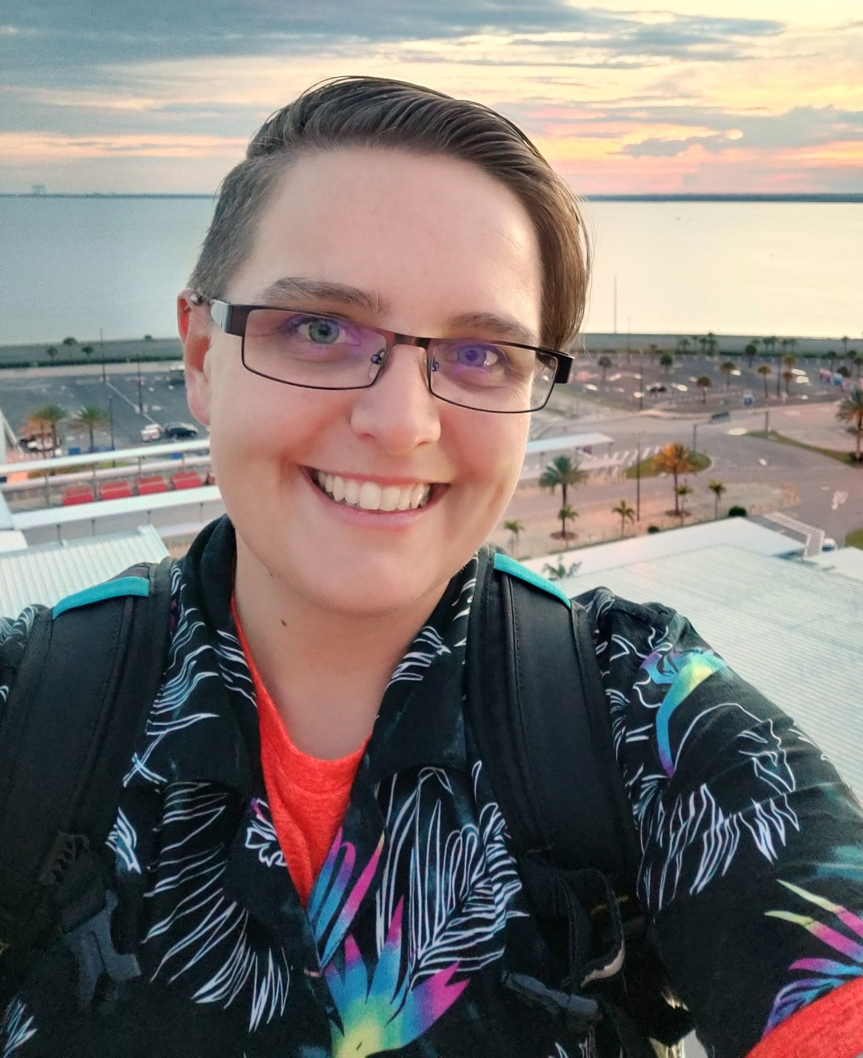
Meet the Secondary Science Team
Tiffany Wendland
Coordinator
Christine Schumacker
Director, PreK-12
Julie Damico
Supervisor
Amy Chilinguerian
Resource Teacher
Joe Davis
Outdoor Educator
Matt Budinger
Outdoor Educator
Katie Dell
Outdoor Educator
Notes:
The Secondary Science Team looks forward to working with and supporting you this year! Please do not hesitate to contact us!

Slide 6
Today’s Agenda
TIME | SESSION
8:00 – 10:30am | Breakout Session 1: Content Area / Grade Level professional development, planning; curriculum updates
10:40 – 11:40am | Breakout Session 2: First Conference Style session; some offerings are repeated in Session 3
11:40am – 12:40pm | Lunch
12:40 – 1:40pm | Breakout Session 3: Second Conference Style session; some offerings are repeated in Session 2
1:45 – 3:00pm | Breakout Session 4: Department Meetings and PSD Reflection Discovery Education Office Hours and Office of Science Office Hour from 2:00 – 3:00pm
Notes:
Review agenda
Remind teachers that Within the online registration system, teachers should register for a section (session) within each of the four Breakout Session “courses”. Courses are titled “Professional Study Day – Secondary Science: Breakout Session #”.

Slide 7

Outcomes
Evaluate a suggested unit resource for alignment to a 3-dimensional, NGSS approach to instruction.
Describe the purpose and value of at least three BCPS curriculum documents.
Begin backwards mapping the first unit of instruction.
Engage in collegial conversations about best practices for equitable science instruction.​
Notes:
Review today’s outcomes; your department chair should have shared information regarding deliverable/expectations for this afternoon’s department meeting time
Image: free svg

Slide 8

Science Community Agreements
Treat each other with dignity and respect
Listen first to understand.
Embrace an inquiry mindset. Questions are the vehicle by which we learn.
Participation is a right and a responsibility. ​
Communicate authentically; what a person says should communicate what they think as well as how they feel.
Expect and accept non-closure.
Notes:
We know and appreciate that you all have A LOT going on. We sincerely value our time together and would like to observe these meeting agreements to make our time as productive and beneficial as possible. Please take a moment to review.
Questions are how we learn
engagement is important – the more you put in, the more you’ll take away from this professional learning
We will always communicate authentically AND we will not always have all the answers. For that reason, we all must expect and accept at least some non-closure as we begin the school year
Image: https://commons.wikimedia.org/wiki/File:Working_Together_Teamwork_Puzzle_Concept.jpg

Slide 9
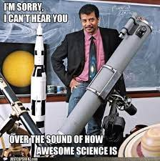
#bringingscienceback
Thinking about science instruction:
What does #bringingscienceback mean?
Think about what’s “working” in science classrooms.
Think about what you would like to see more of in science lessons. Less of?
Notes:
Begin by 8:15 (5 minutes)
One of the best things about returning to in-person instruction is #bringingscienceback to the classroom. #bringingscienceback is our theme for PSD this school year
Ask, “What does #bringingscienceback mean to you?” Teachers may share examples from last year or things they have planned for this coming year.
Give Ts a minute or so to think about the second and third bullets
Image: pinterest

Slide 10
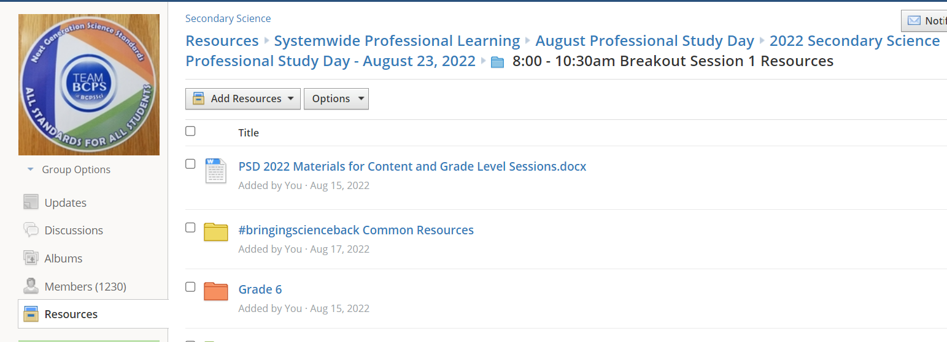
#bringingscienceback
Review these resources (posted in the 2022 PSD folder in Schoology→#bringingscienceback Common Resources):
  New Vision for Science Education
  3-D Lesson Screening Tool
Notes:
(7-8 minutes)
As we are #bringingscienceback, we felt it was a good time to remind ourselves about our targets for high-quality science instruction. Let’s bring AWESOME science back!
Review directions and give teachers time to review resources, record answers to #2 on their own paper, electronic document, their choice.
Ask for a few share outs
Image: https://dpi.wi.gov/science/assessment/examples

Slide 11
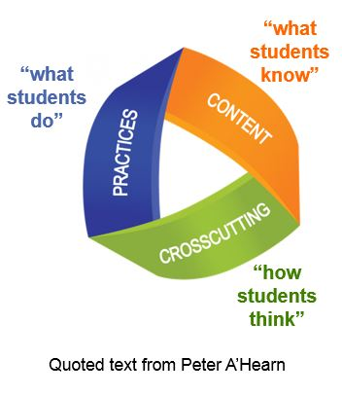
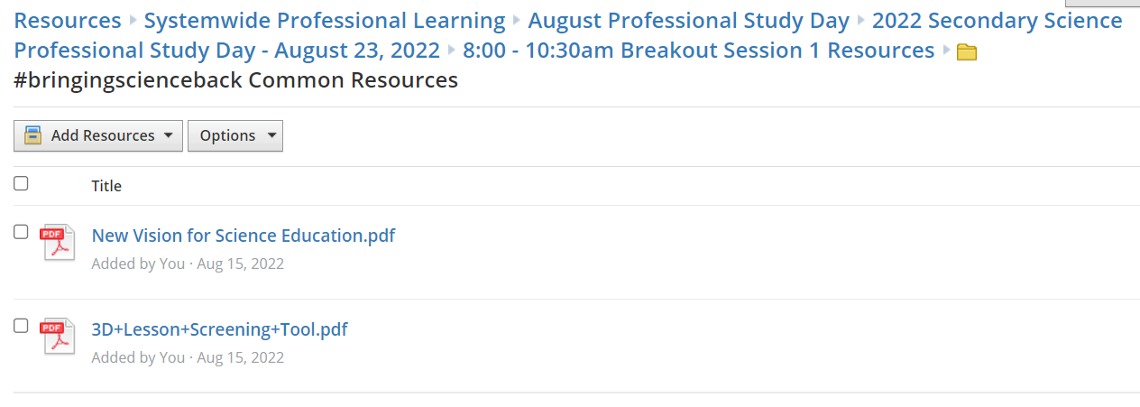
#bringingscienceback
Record how these resources align to:
  what you and your students enjoy about science
  what you would like to see more of/less of in your science classroom
Notes:
(7-8 minutes)
As we are #bringingscienceback, we felt it was a good time to remind ourselves about our targets for high-quality science instruction. Let’s bring AWESOME science back!
Review directions and give teachers time to review resources, record answers to #2 on their own paper, electronic document, their choice.
Ask for a few share outs
Image: https://dpi.wi.gov/science/assessment/examples

Slide 12
Science is #phenomenal!
Think “figuring out” versus “learning about”…
What might students figure out or make sense of from this phenomenon (DCIs)?
What SEPs might they engage in as they are figuring things out?
What CCCs might they use to support their sensemaking?
Notes:
Start by 8:30
One characteristic of the “new” vision and NGSS (3-dimensional) approach to instruction is making sense of phenomena. Think “figuring out” versus “learning about.”
As teachers view/briefly engage in phenomenon related to first unit of instruction, ask them to respond to these questions; review acronyms as needed
Progressions for all three dimensions are posted in the #bringingscienceback Common Resources folder in the 2022 PSD folder in Schoology)

Slide 13
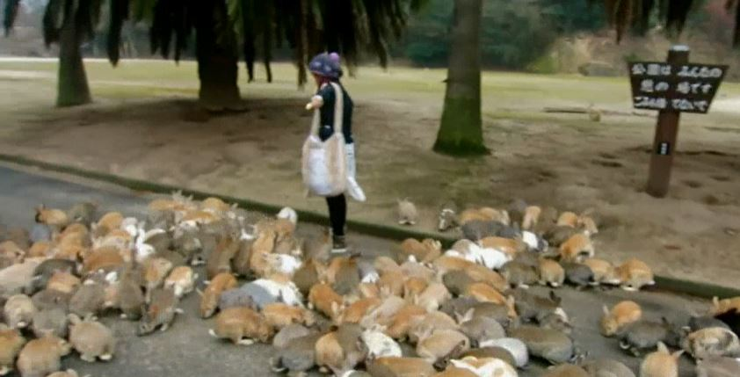
Science is #phenomenal!
Grade 6 – Ecosystem Interactions
Notes:
Start by 8:32
Watch the first 50 seconds of this video clip about “Bunny Island” (Okunoshima Island) in Japan.
What about ECOSYSTEMS or POPULATIONS might students figure out or make sense of from this phenomenon? (disciplinary core ideas)
What SEPs might they engage in as they are figuring things out? (science and engineering practices) – pick two
What CCCs might they use to support their sensemaking? (crosscutting concepts) – pick two
Discovery Education video: Rapidly Reproducing Rabbits | Discovery Education

Slide 14
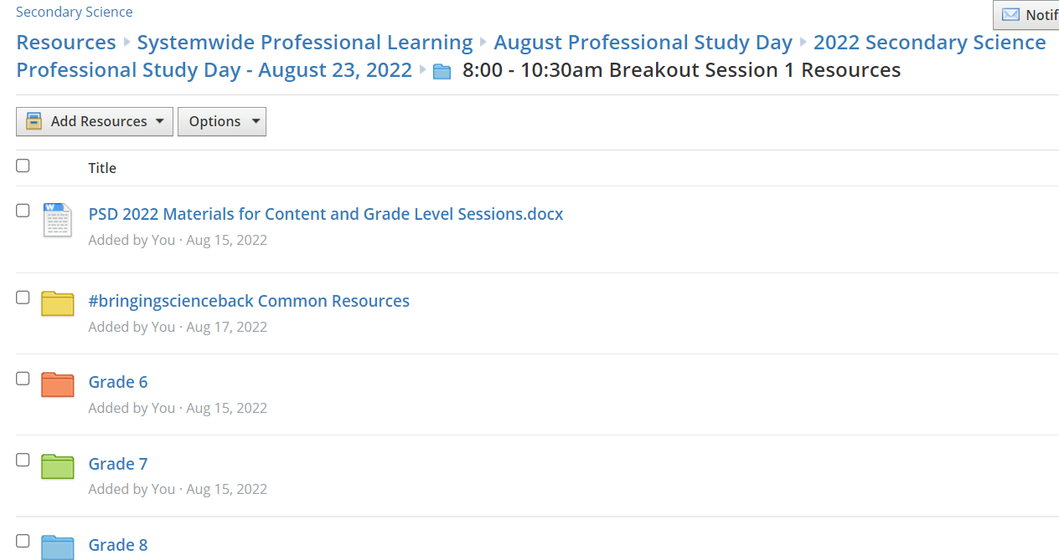

#bringingscienceback
Groupwork via a blended approach
We’ve selected a recommended resource from Unit 1
“handout” if applicable is available in grade level/course folder
Notes:
Begin by 8:45 (2 minutes)
We’ve selected a recommended resource within the first unit of instruction. The resource could be a sample lesson or hands-on activity or a resource from a sample digital lesson. The resource may or may not be directly related to the phenomenon we just explored.
“Handouts”, if applicable, are in the PSD folder in Schoology in the respective breakout session folders. Other materials have been curated by your department chair, lab paraeducator, and/or team lead – thank you!!!
Image: https://dpi.wi.gov/science/assessment/examples

Slide 15
#bringingscienceback
Groupwork – 40 minutes total
If at school, divide into smaller groups (2 to 4 folks) as needed.
Review and work through the activity using materials, if available.
Use the resources (New Vision and 3-D Lesson Screening Tool plus Practices & Concepts Cards, 5E Model) and best practices you have observed to:
  Identify ways lesson/activity is in alignment with a 3-D/NGSS instructional approach
  Make suggestions for how to bring lesson/activity more in alignment with a 3-D/NGSS instructional approach
Record small-group (if applicable) commendations and suggestions on white board, paper, or electronically
Record whole-group responses on respective Jamboard (links in PSD folder)
Notes:
(5 minutes)
Review directions
If activity is part of a sample lesson, review lesson as a whole, but focus your group time on the selected activity.

Slide 16
#bringingscienceback
COURSE / GROUP | UNIT 1 TITLE | LEARNING CYCLE (LC) | RESOURCE FROM UNIT RESOURCES DOCUMENT
Grade 6 | Ecosystem Interactions | LC 1: Resource or Not? | Owl Population Growth Simulation
Grade 7 | S’more Energy | LC 1: Energy Transformation and Conservation | Design an investigation to explore the amount of time it takes to heat or cool different masses of water.
Grade 8 | Climate Detectives | LC 2: Factors Influencing Climate | Science Explorer – Weather and Climate – Chapter 4, pg. 123 “Modeling Climate” Try This Activity
Notes:
(1 minute)
We’ve selected a recommended resource within the first unit of instruction. The resource could be a sample lesson or hands-on activity or a resource from a sample digital lesson.
“Handouts”, if applicable, are in in the PSD folder in Schoology. Other materials have been curated by your department chair, lab paraeducator, and/or team lead – thank you!!!
NO HANDOUTS for Grade 7 or 8; For Grade 8, teachers may reference page 123 of the Weather and Climate Science Explore text

Slide 17
#bringingscienceback
Groupwork – 40 minutes total
If at school, divide into smaller groups (2 to 4 folks) as needed.
Review and work through the activity using materials, if available.
Use the resources (New Vision and 3-D Lesson Screening Tool plus Practices & Concepts Cards, 5E Model) and best practices you have observed to:
  Identify ways lesson/activity is in alignment with a 3-D/NGSS instructional approach
  Make suggestions for how to bring lesson/activity more in alignment with a 3-D/NGSS instructional approach
Record small-group (if applicable) commendations and suggestions on white board, paper, or electronically
Record whole-group responses on respective Jamboard (links in PSD folder)
Notes:
(2 minutes)
Repost/reshare directions and the ultimate purpose (see below)
If activity is part of a sample lesson, review the lesson as a whole, but then focus your group time on the selected activity.
This is going to be QUICK – you don’t have to conduct/perform the activity from start to finish and if you do not have access to materials, that is okay. The FOCUS of this part of today’s professional learning is on commendations and suggestions for a 3-D/NGSS approach to instruction.
RECONVENE at 9:40 to review Jamboard reflections.

Slide 18
#bringingscienceback
Summary Discussion and Reflection
Share out – what patterns do we see?
How are these patterns related to what we would like to see “more of” in science classrooms?
What supports do you need for incorporating a 3-D/NGSS approach in your lessons?
Notes:
Begin by 9:40 (5 minutes)
Review and discussion commendations and suggestions from Jamboard.
What patterns do we see?
How are these patterns related to what we would like to see more of in science classrooms? Ways to make science instruction more equitable?
Office of science will use feedback about supports to guide 22-23 professional learning.

Slide 19
CURRICULUM UPDATES
TITLE OF WORKSHOP | PRIMARY GOALS
Middle School Curriculum Based Assessments (Grades 6, 7, and 8) | Update Learning Cycle Summative Assessments for better alignment to NGSS and MISA format Identify additional hands-on and collaborative resources Develop sample unit plans
High School Curriculum Based Assessments (Earth Systems, Living Systems, and IPC) | Update Learning Cycle Summative Assessments for better alignment to NGSS and MISA format Identify additional hands-on and collaborative resources
NGSS Physics | Update Learning Cycle Summative Assessments for better alignment to NGSS and MISA format Added resources to Learning Cycles including GT/AA Added Pre-Assessments where appropriate
Notes:
Begin by 9:45 (2 minutes)
A HUGE thank you to you and your students for providing us with feedback in June and to our #of colleagues who participated in curriculum writing this summer and.
We had three curriculum writing workshops this summer. Briefly review titles and primary goals.

Slide 20

CURRICULUM UPDATES
Curriculum writers prioritized work on the first two units of instruction for each course
Unit 2 documents are undergoing final review and will be available in Schoology no later than September 9th.
Subsequent unit resources will be uploaded once they are finalized
Check for updates in the Secondary Science Group.
Notes:
(2 minutes)
Share information about curriculum priority work and availability of Unit 2 and later units.
We’re now going to spend some time reviewing curriculum documents and discuss how these documents can support your science unit and lesson planning.

Slide 21
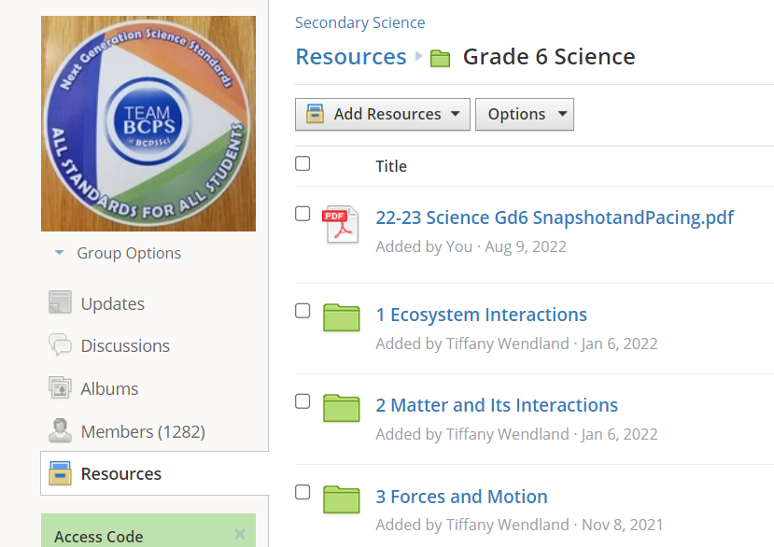
CURRICULUM UPDATES
22-23 Course Snapshot and Pacing Guide
Located at the top of each course/grade level folder
Open a Snapshot and Pacing Guide document for a course you are teaching this year
What planning guidance does this document provide?
Notes:
(5 minutes)
Facilitators may choose to pull up their respective course snapshot and share during the presentation
Snapshot and pacing guides developed for our core courses: Grades 6, 7, 8, Earth, Living, IPC, NGSS Chemistry and NGSS Physics.
This document is located at the top of the grade level/course folder
Please take a few minutes to open up the snapshot for a course that you are teaching this year.
What planning guidance does this document provide? Units with learning cycle titles and topics; ends-by dates for each unit (plus each LC for Grades 6, 7, and 8); suggested number of 50-minute (middle school) or 80 to 90-minute classes (high school); standards linked to evidence statements
Ends-by dates are the same for middle schools on 50-minute or A/B Day (block) schedules

Slide 22
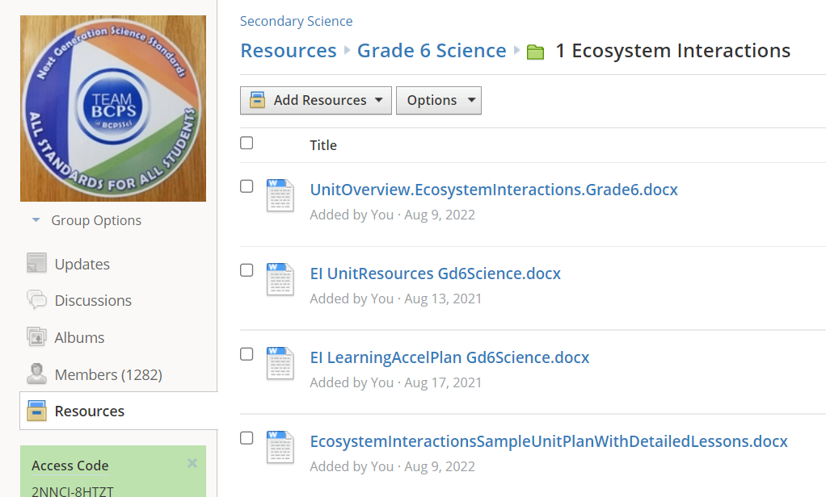
CURRICULUM UPDATES
Unit Overview
First document in each unit folder
Updated content and format for 22-23
Open a Unit Overview for the first unit of a course you are teaching this year.
What planning guidance does this document provide?
Notes:
(5 minutes)
Facilitators may choose to pull up their respective Unit 1 Unit Overview during the presentation
Unit level unit overviews updated for our core courses Grades 6, 7, 8, Earth, Living, IPC, NGSS Chemistry and NGSS Physics.
This document is located at the top of each unit folder
Please take a few minutes to open and review the unit overview for the first unit of a course you are teaching this year.
What planning guidance does this document provide? Suggested pacing, high-level overview, standards linked to evidence statements, prior knowledge, riving, essential and topic questions, big ideas/enduring understandings, assessment information, misconceptions academic vocabulary

Slide 23
CURRICULUM UPDATES
Unit Resources Document
Second document in each unit folder
Open the Unit Resources document for the first unit of a course you are teaching this year.
What planning guidance does this document provide?
Notes:
(5 minutes)
Facilitators may choose to pull up their respective Unit 1 Unit Resources document during the presentation
Unit level unit resources documents updated for Grades 6, 7, 8, Earth, Living, and IPC; focus was adding more hands-on and collaborative activities/resources
This document is the second document in each unit folder
Please take a few minutes to open and review the unit resources document for the first unit of a course you are teaching this year.
What planning guidance does this document provide? Recommended hands-on and digital resources for daily lesson planning; NOTE Science Explorer activities for Middle School Courses; information about learning cycle summative assessments – format, whether they’re updated from last year or new; if administered in Performance Matters, window close dates

Slide 24
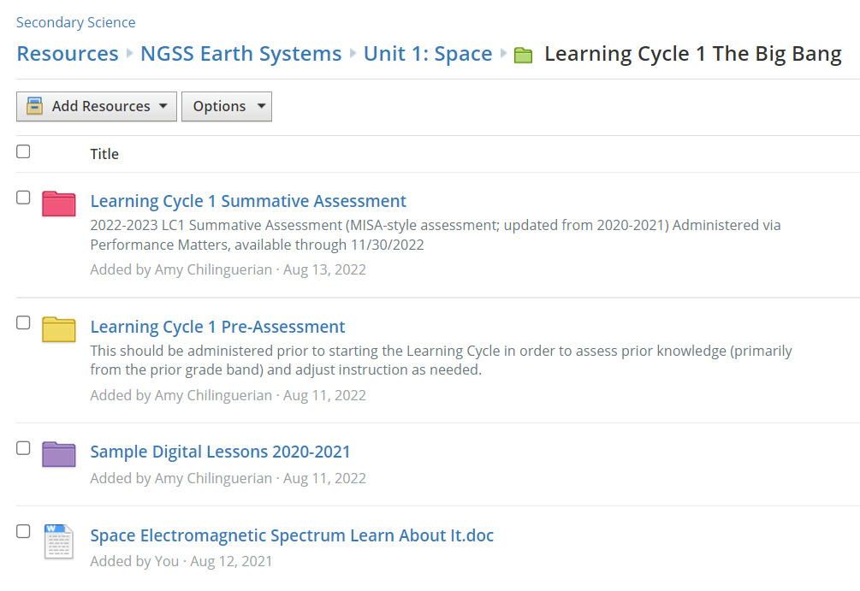
CURRICULUM UPDATES
Learning Cycle Summative Assessments
Available in their respective Learning Cycle folder
Begin with the TR(S) to review any implementation suggestions and scoring information
Review the LC Summative Assessments for the first unit of instruction
Notes:
(5 minutes)
Facilitators may choose to pull up their respective Unit 1 Learning Cycle Summative Assessments to share during the presentation, making note of important changes as needed
It is IMPERATIVE that teachers are using the most current version of the assessments, which are located in their respective Learning Cycle folder
Learning Cycle Summative assessments for Grades 6, 7, 8, Earth, Living, and IPC were updated to better align to their respective standards and – where appropriate- to be more MISA-like in format. We will continue to have a variety of summative assessments in our science curriculum so that we are providing students with a variety of ways to demonstrate mastery.
Beginning with the TR(S)s, please take a few minutes to open and review the LC summative assessments for the first unit of a course you are teaching this year.

Slide 25
CURRICULUM UPDATES
Performance Matters
A table identifying the curriculum-based assessments (CBAs) built in Performance Matters (PM) for each course is available on the main Resources Page of the Secondary Science Group.
If a CBA, e.g., Learning Cycle Summative Assessment, is available in Performance Matters, teachers are expected to administer the assessment via Performance Matters.
Teachers may use the MS Word versions of Learning Cycle Summative Assessment to provide accommodations required for students receiving special services, e.g., IEPs, 504s, ESOL supports
Notes:
(2 minutes)
Review
Remind teachers that assessments built in PM are the same as the MS Word versions available in Schoology with some slight changes in question type, e.g., drop-down fill-in versus circle the answer choices.

Slide 26
CURRICULUM UPDATES
Performance Matters
Professional Learning on Performance Matters is being offered today and we will continue to provide PD throughout the school year
For questions specific to Secondary Science PM assessments, please email Julie Damico jdamico@bcps.org
For systemic or functionality questions, please email pm@bcps.org, reference support materials in the Performance Matters Training Course (Access Code: HW7K-RC68-MRK9S) or post an update to the course.
Notes:
(2 minutes)

Slide 27

CURRICULUM UPDATES
Other curriculum documents
Pre-Assessments
Learning Acceleration Plan
Sample Unit Plan
Supports for Multilingual Learners (MLL)
  Grade 6 & Living Systems Unit 1 Field Test
  LC Summative Assessment support
  Vocabulary and other language acquisition
Curriculum Support & Feedback Form
Notes:
(5 minutes) Facilitators may choose to pull up their respective “other” documents to share during the presentation
Other documents that may assist with planning and differentiating instruction; not all courses will have all of these documents
Pre-Assessments provide data on prior learning
Learning Acceleration Plan offer resources for “just-in-time” instructional resources to address gaps
Sample Unit Plan offers daily instructional activities and outcomes
For the first units of Grades 6 and Living Systems, teachers may utilize/field test supports for Multilingual Learners
Curriculum support and feedback form available at the bottom of every course folder in Schoology

Slide 28

Time to Plan/Share
Share #bringingscienceback or other awesome ideas you have planned for the first week and/or unit
Additional planning resources in the PSD #bringingscienceback Common Resources folder to use today and throughout the year
  A/B Day planning calendar
  STEM Teaching tools for incorporating SEPs and CCCs into assessments and other tasks
  5E Lesson Plan template
Use those Resource Share Groups!! ☺
Notes:
10:15
Time for Ts to share ideas for first week/unit
Additional planning resources in #briningscieneback Common Resources folder
Encourage joining and using Resource Share Groups to share resources/activities and collaborate with colleagues across the system

Slide 29

Optimistic Closure
Thank you and have a great year!
What was one thing you appreciated about this session?
What is one thing you are willing to try or learn more about?
Don’t forget to Register for Sessions 2, 3 & 4!
Notes:
10:25

Slide 30
Optimistic Closure
Thank you and have a great year!
Reach out if you need us!
Julie Damico, Supervisor jdamico@bcps.org
Tiffany Wendland, Coordinator twendland@bcps.org
Christine Schumacker, Director cschumacker@bcps.org
Office: 443-809-4251

